Slide 1
Poolit
Carpool that puts security and privacy at the heart🛡

Slide 2
Contents
Introduction
Technology we used
Main Features
Design Detail
Design Test
Conclusion
Instructions for use and final slides with:
The fonts and colors used in the template.
A selection of illustrations. You can also customize and animate them as you wish with the online editor. Visit Storyset to find more.
More infographic resources, whose size and color can be edited.
Sets of customizable icons of the following themes: general, business, avatar, creative process, education, help & support, medical, nature, performing arts, SEO & marketing, and teamwork.

Slide 3
Table of Contents
01
02
03
04
About Our Company
Services/Products
Here you could describe the topic of the section
Our Clients
Expected Projection

Slide 4
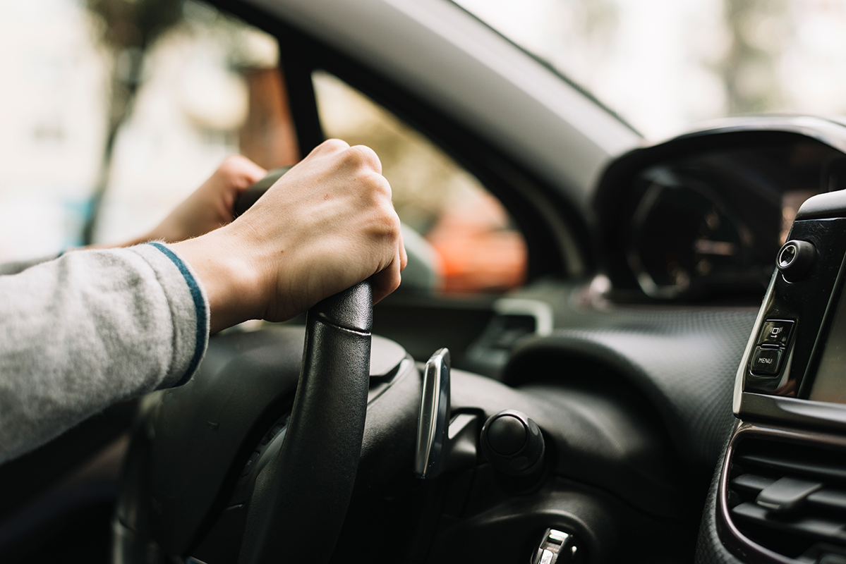

01
Introduction

Slide 5
Introduction
Karlpol is an environmentally friendly car-sharing APP designed to provide people with safe, convenient and intelligent rides.

Slide 6
Technology We Used
Google Map API
Vue.js
Firebase
Bootstrap
Javascript
HTML/CSS

Slide 7
Main features
Frontends
Backends
Introduction Page
Sign in/up
Map Interaction
Verification System
User ORM
Rate Limiter

Slide 8
Design Details

Slide 9
Backends
MERCURY
VENUS
MARS
Mercury is the closest planet to the Sun
Venus has a beautiful name, but it’s terribly hot
Despite being red, Mars is a cold place
JUPITER
NEPTUNE
SATURN
It’s the biggest planet in the Solar System
Neptune is the farthest planet from the Sun
Saturn is the ringed one and a gas giant

Slide 10
Frontends
MERCURY
VENUS
MARS
Mercury is the closest planet to the Sun
Venus has a beautiful name, but it’s terribly hot
Despite being red, Mars is a cold place
JUPITER
NEPTUNE
SATURN
It’s the biggest planet in the Solar System
Neptune is the farthest planet from the Sun
Saturn is the ringed one and a gas giant

Slide 11
—SOMEONE FAMOUS
“This is a quote, words full of wisdom that someone important said and can make the reader get inspired.”

Slide 12
Locations
L
L
L
L
LICENSES
Find out where all our offices around the world are located in this map

Slide 13
Best Sellers
3º
1º
2º
Saturn is the gas giant with the rings all around it
Despite being red, Mars is actually a cold place
Venus has a quite beautiful name, but it’s terribly hot

Slide 14
Our Strengths
LOYALTY
EFFICIENCY
Neptune is the farthest planet from the Sun
Despite being red, Mars is actually a cold place
RELIABILITY
COMMITMENT
Mercury is the closest planet to the Sun
Jupiter is the biggest planet in the Solar System

Slide 15

Customer Profile
GENDER
AGE
60%
40%
To modify this graph, click on it, follow the link, change the data and paste the new graph here
CLASS -A-
CLASS -B-

Slide 16
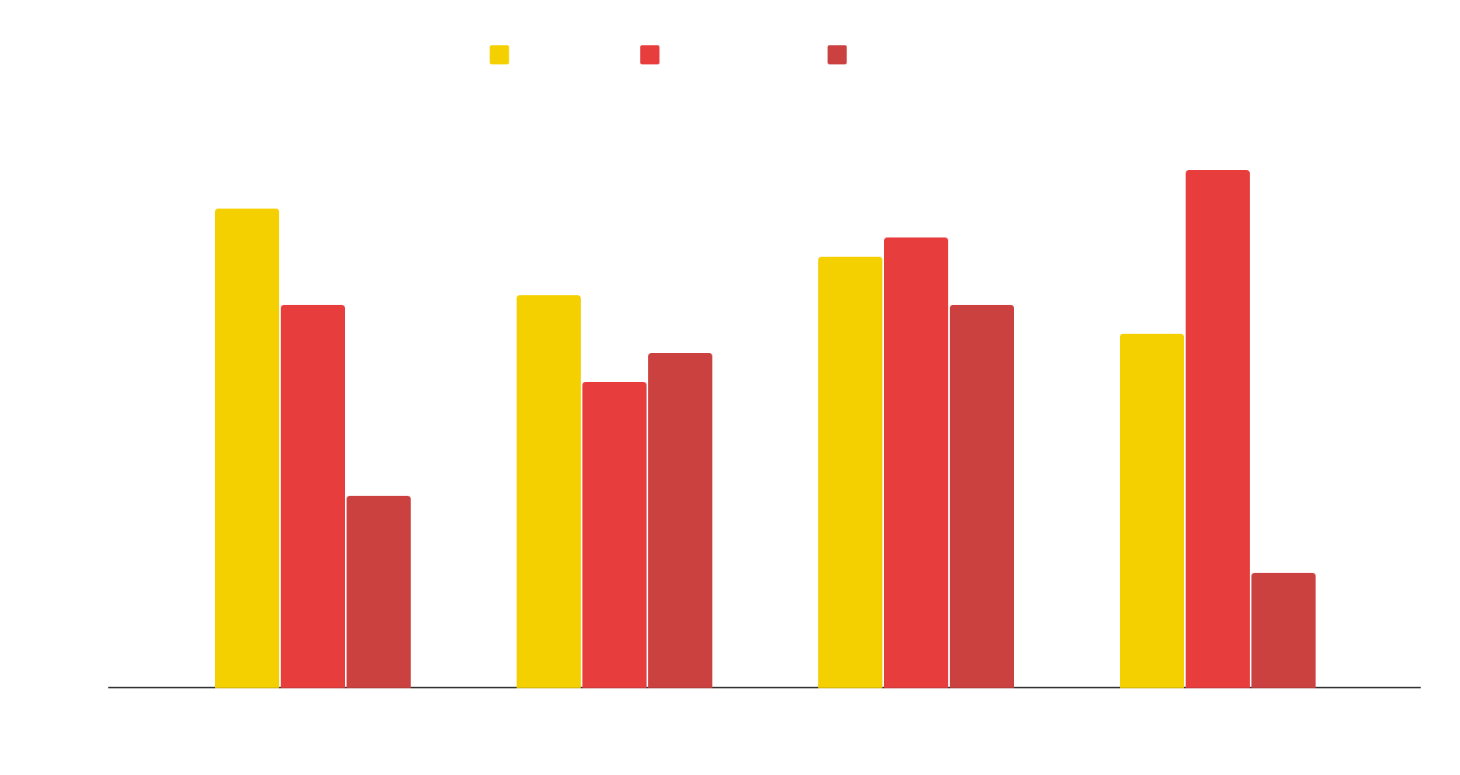
Our Numbers
65%
35%
To modify this graph, click on it, follow the link, change the data and paste the resulting graph here
Success
Failure
$28.87
30 DAYS
45 SHOPS
avg. price per unit
avg. days on market
amount of retailers

Slide 17
85,320
NEW DRIVERS EVERY YEAR

Slide 18
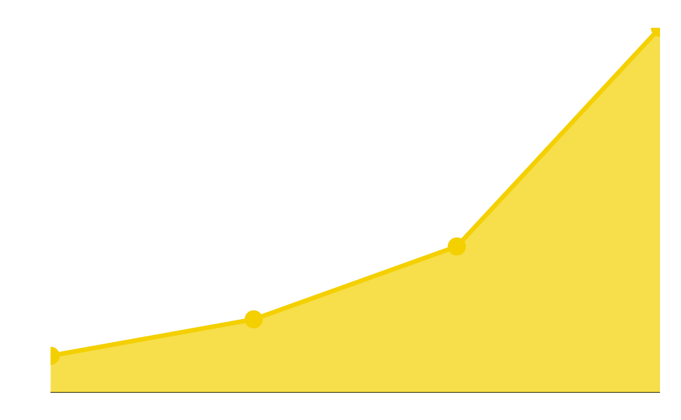
Our Growth
20,000
100
Expected income for 2021
New employees next year
To modify this graph, click on it, follow the link, change the data and paste the resulting graph here

Slide 19
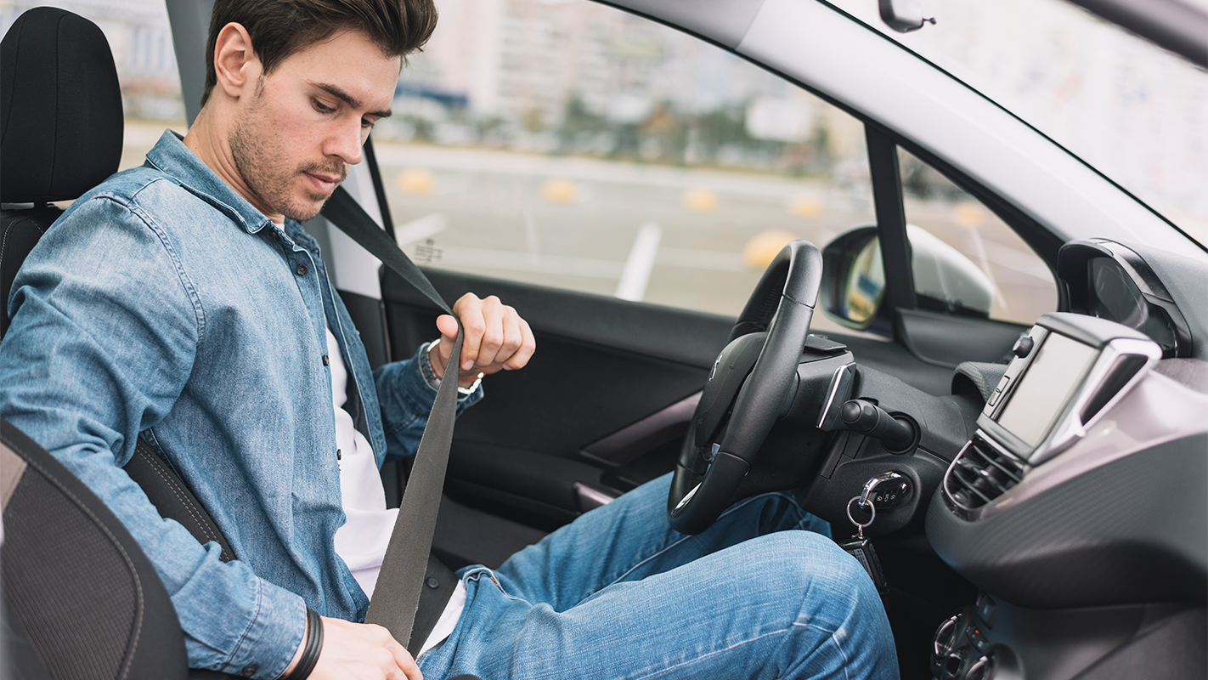
A Picture Is Worth a Thousand Words

Slide 20
Future Projects
1
MERCURY
Mercury is the closest planet to the Sun
2
VENUS
It has a beautiful name, but it’s hot
3
MARS
Despite being red, Mars is a cold place

Slide 21
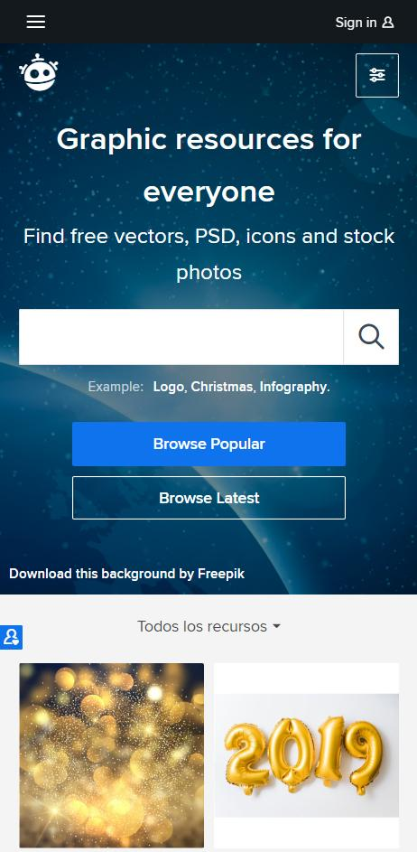
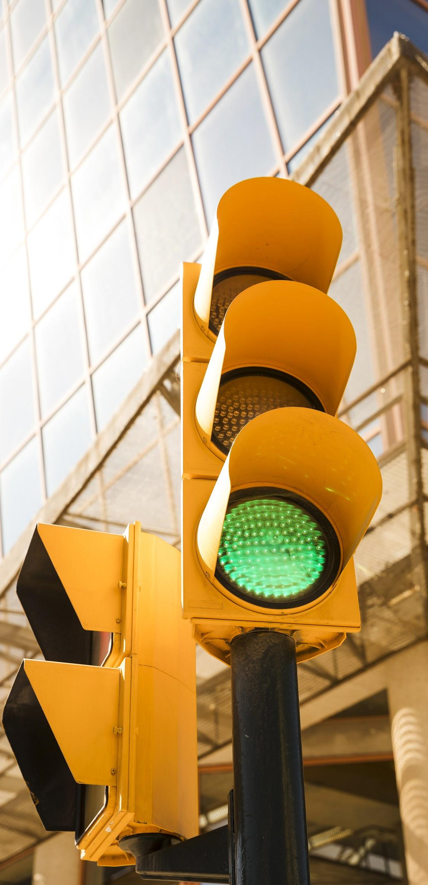
Future Projects
I.A. DRIVER TEST
DRIVE
START
Mercury is the closest planet to the Sun and the smallest one in the Solar System—it’s only a bit larger than the Moon. The planet’s name has nothing to do with the liquid metal, since Mercury was named after the Roman messenger god

Slide 22
Customer Testimonials
JOHN PATTERSON
HELENA JAMES
XX.XXXX.XXX
XX.XXXX.XXX
“Despite being red, Mars is a cold place. The planet is full of iron oxide dust.”
“Mercury is the closest planet to the Sun and the smallest one in the Solar System.”
XX DRIVER LICENSE XX
XX DRIVER LICENSE XX

Slide 23
Awards
MERCURY
VENUS
JUPITER
Mercury is the closest planet to the Sun and the smallest one in the Solar System
Venus has a beautiful name and is the second planet from the Sun. It’s terribly hot
Despite being red, Mars is actually a cold place. It’s full of iron oxide dust

Slide 24
Our Fleet
 | BASIC | PREMIUM | ELITE
MERCURY
MARS
SATURN

Slide 25
Our Team
JENNA DOE
JOHN JAMES
JANE PATTERSON
Despite being red, Mars is a cold place full of iron oxide dust
Jupiter is a gas giant and the biggest planet in the Solar System
Mercury is the closest planet to the Sun and the smallest one

Slide 26
THANKS
Do you have any questions?
addyouremail@freepik.com
+91 620 421 838
yourcompany.com
Please keep this slide for attribution.

Slide 27
Alternative Resources

Slide 28
Alternative Resources

Slide 29
Resources
Did you like the resources on this template? Get them for free at our other websites:
PHOTOS
Green color traffic light
Close up man driving car
Young Man
VECTORS
Garage icons collection
Blank vehicle license plate
Futuristic interior design of car
Colored city map
Realistic billboard
Car presentation template
Top view of flat cars on parking lot
Flat urban landscape
Flat hand holding car key
Car pictograms set
Collection of signs
Set of traffic signs

Slide 30
Thank You! Q&A

Slide 31
Instructions for use
In order to use this template, you must credit Slidesgo by keeping the Thanks slide.
You are allowed to:
- Modify this template.
- Use it for both personal and commercial projects.
You are not allowed to:
- Sublicense, sell or rent any of Slidesgo Content (or a modified version of Slidesgo Content).
- Distribute Slidesgo Content unless it has been expressly authorized by Slidesgo.
- Include Slidesgo Content in an online or offline database or file.
- Offer Slidesgo templates (or modified versions of Slidesgo templates) for download.
- Acquire the copyright of Slidesgo Content.
For more information about editing slides, please read our FAQs or visit Slidesgo School:
https://slidesgo.com/faqs and https://slidesgo.com/slidesgo-school

Slide 32
Fonts & colors used
This presentation has been made using the following fonts:
Krona One
(https://fonts.google.com/specimen/Krona+One)
Ubuntu
(https://fonts.google.com/specimen/Ubuntu)
#f4d000
#ceb200
#e83d3d
#b2322e
#00abbf
#336574
#1f424c

Slide 33





Stories by Freepik
Create your Story with our illustrated concepts. Choose the style you like the most, edit its colors, pick the background and layers you want to show and bring them to life with the animator panel! It will boost your presentation. Check out How it Works.
Pana
Amico
Bro
Rafiki
Cuate

